Slide 1

City of boston: BuildING violations
summer 2024
Julissa Mijares and Tauriel Duan
PM: Wentao Chen

Slide 2
Datasets- 2019 TO 2024
PROPERTY ASSESSMENTS
BUILDING AND PROPERTY VIOLATIONS
311
LIVE STREET ADDRESS MANAGEMENT (SAM)
PUBLIC WORKS
VIOLATIONS
‹#›

Slide 3
Base Questions
Are there certain landlords/management companies that have repeated violations?
1
2
Are there common features of certain buildings?
3
What neighborhoods/communities are affected most?
What kinds of building complaints are people making around the city?
4

Slide 4
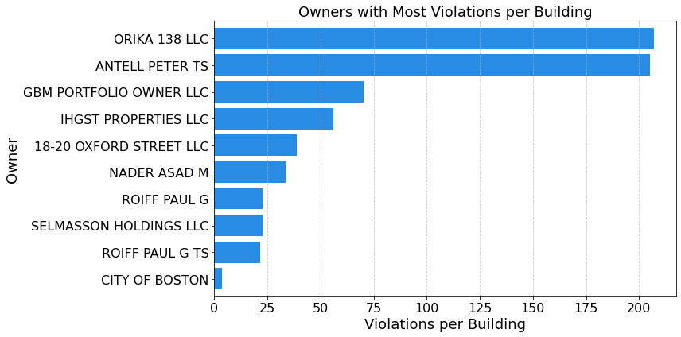
REPEATED LANDLORDS/ COMPANIES
INSIGHTS
Majority LLC - hard to identify individuals
Peter Antell - Died in 2021
Paul Roiff

Slide 5
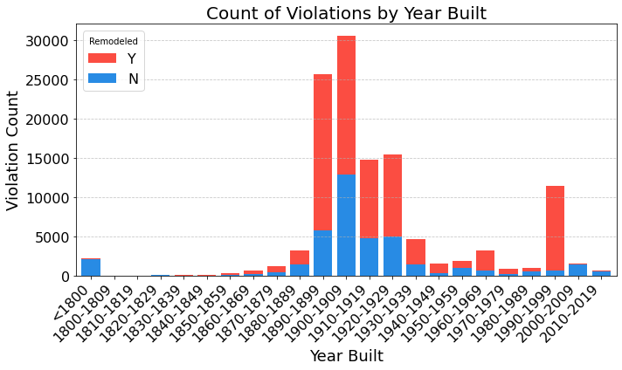
common Features
INSIGHTS
Older Buildings (1890-1930) but recently renovated
Spike during 1990s
Bad landlords vs old buildings

Slide 6
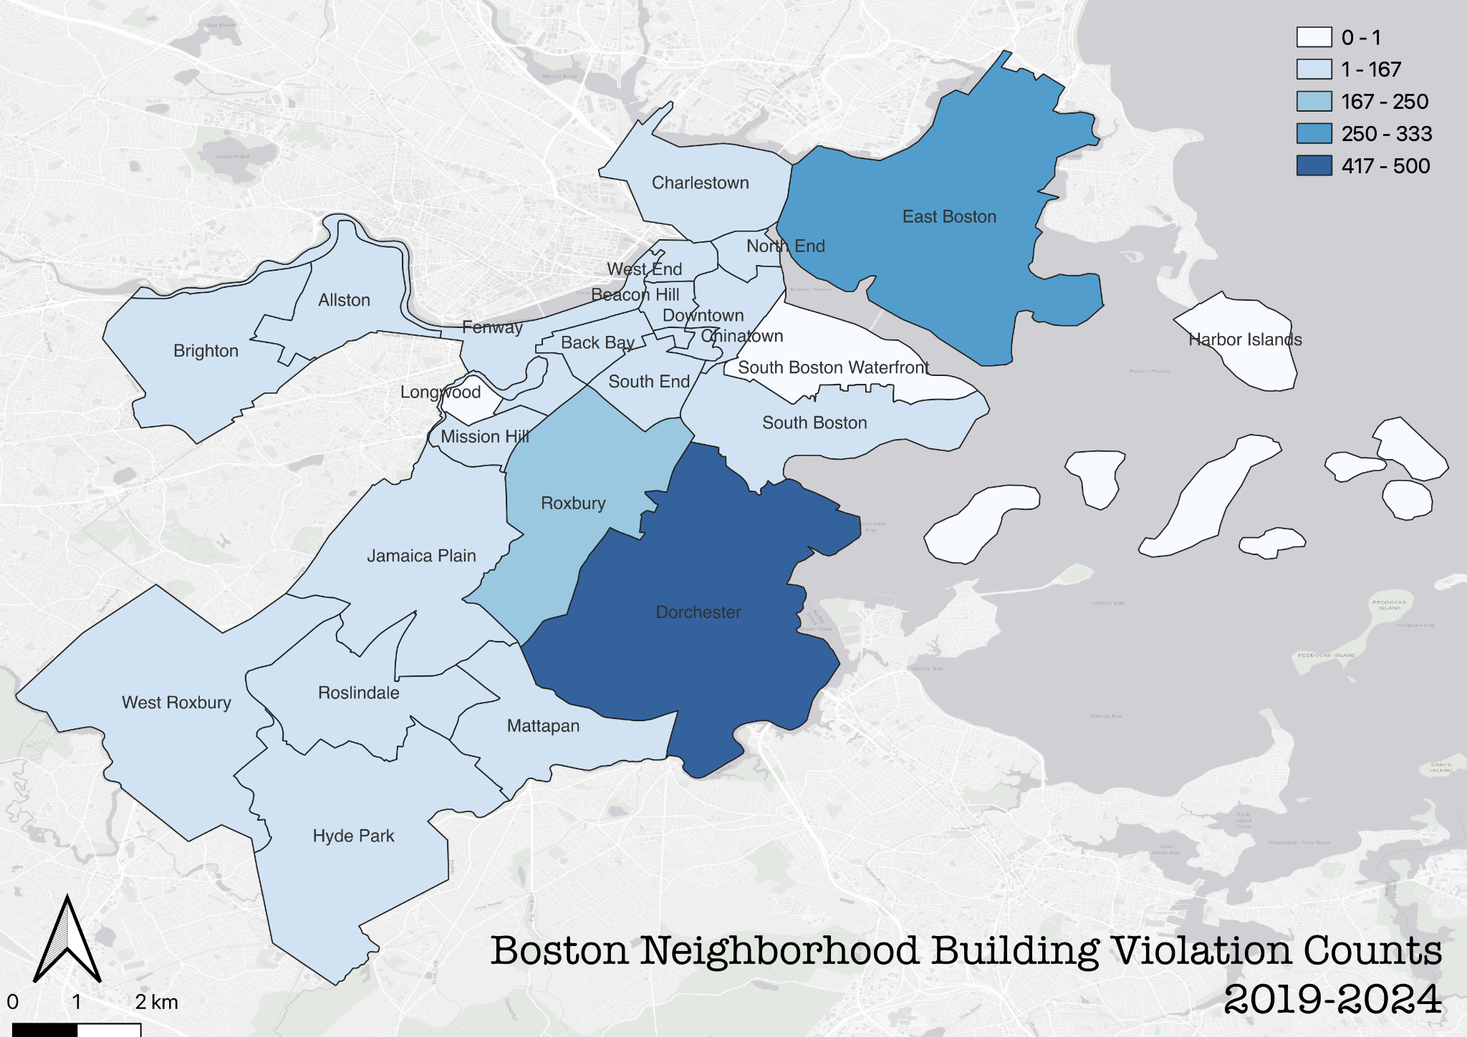
affected communities
INSIGHTS
By count:
Dorchester, East Boston, and Roxbury
Normalization needed

Slide 7
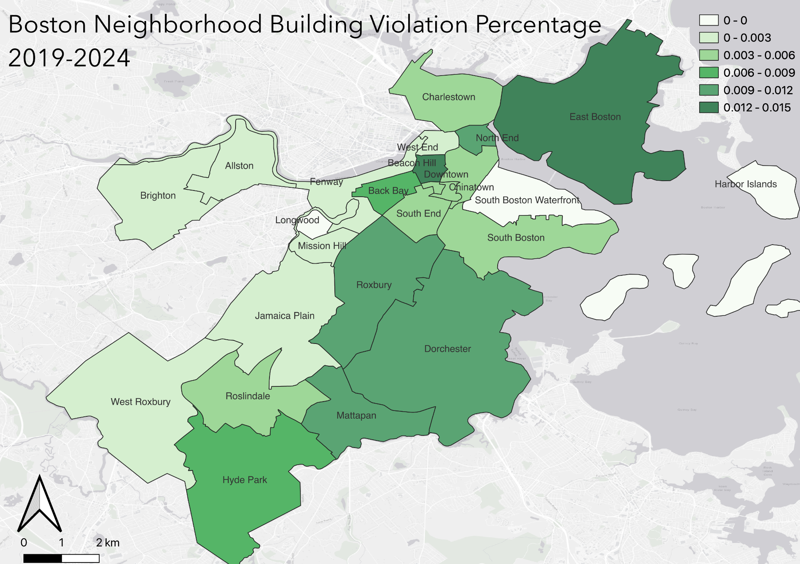
affected communities
INSIGHTS
By percentage:
East Boston, Beacon Hill, North End
Have older buildings, correspond with the answer to Q2

Slide 8
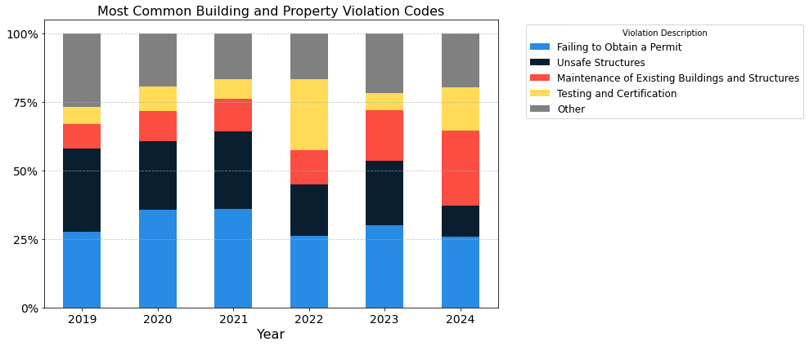
Types of complaints- BUILDING VIOLATIONS

Slide 9
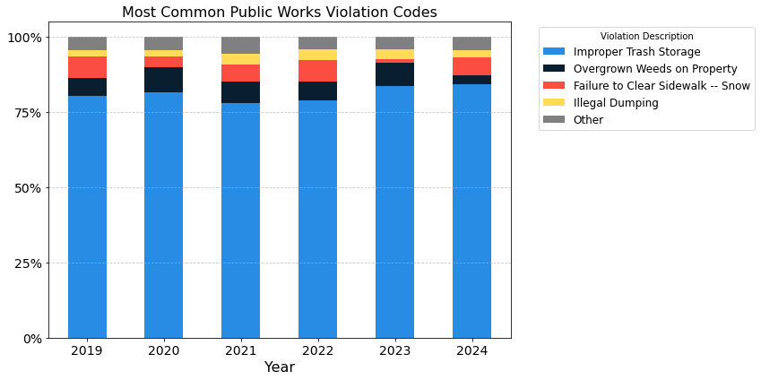
Types of complaints- PUBLIC WORKS VIOLATIONS

Slide 10
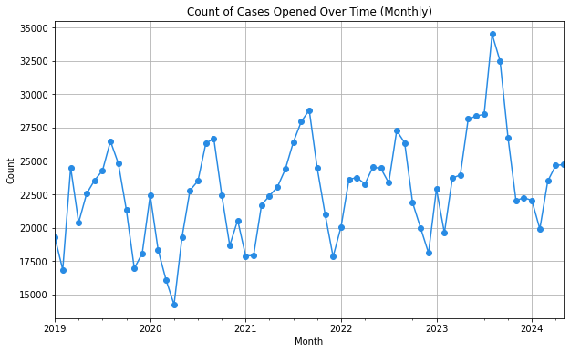
Types of complaints- 311
INSIGHTS
Seasonal trend
High- Aug to Sep
Low- Nov to Feb
Most common relevant complaint
Unsatisfactory Living Conditions

Slide 11
cONCLUSION
A small number of landlords and management companies, such as LLCs, are responsible for a large number of violations
Buildings constructed in the early 1990s and renewed in the late 1900s and early 2000s are more prone to having violations
East Boston, Beacon Hill and North End neighborhoods have the highest building violation rates
The most common types of violations relate to failure to obtain permits, unsafe structures, and improper maintenance
Boston 311 data top complaints: rodent activity, graffiti removal, and unsatisfactory living conditions

Slide 12
q&a

Slide 13
Thank you
Questions?

